Slide 1
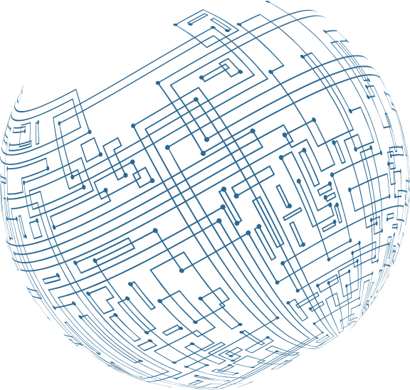

CTEC 445 Project
: Exploring the Pigpen Cipher
A Historical Substitution Cipher Used in Secret Communications
Bangalie koroma, Antonette Simms, Lassine P Guindo , Lucky Uchendu , Marcus Jackson, Tyrek Kelly, Ulises Servellon

Slide 2

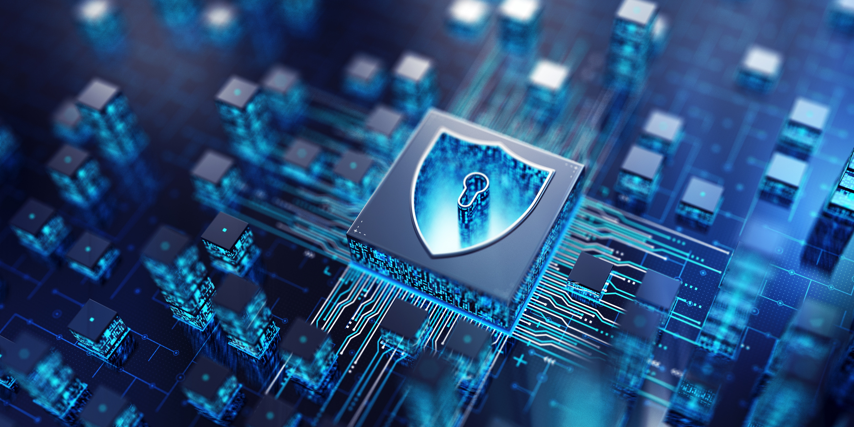
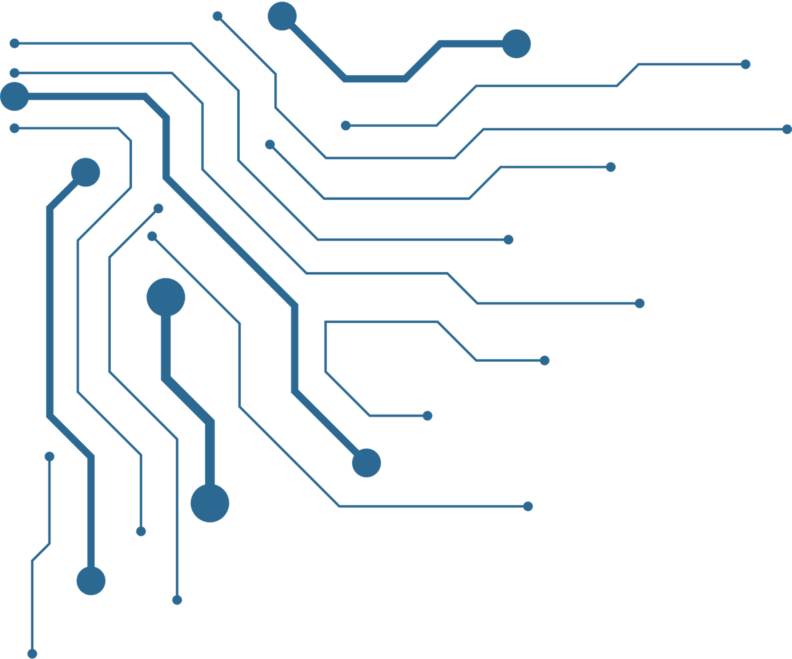
Overview and Historical Context
The Pigpen Cipher is a substitution cipher that replaces letters with symbols based on a geometric grid system.
Used historically by Freemasons, the Rosicrucians, and other secret societies for confidential messages.
Dates back to at least the 18th century, with variations seen in earlier cryptographic methods.
Despite its simplicity, it was effective for informal secret communication.

Slide 3
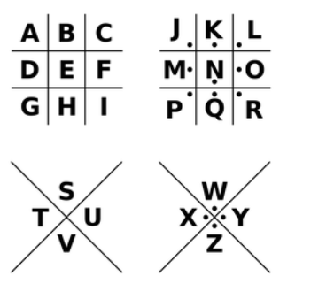
Pigpen Cipher Grid System
The cipher uses two 3x3 grids and two X-shaped grids to assign symbols to letters.
Letters A-I are placed in a 3x3 grid without dots.
Letters J-R are placed in the same grid but with dots.
Letters S-Z are placed in an "X" shaped grid without dots, and with dots for the remaining letters.
Each letter is replaced by its corresponding symbol during encryption.

Slide 4
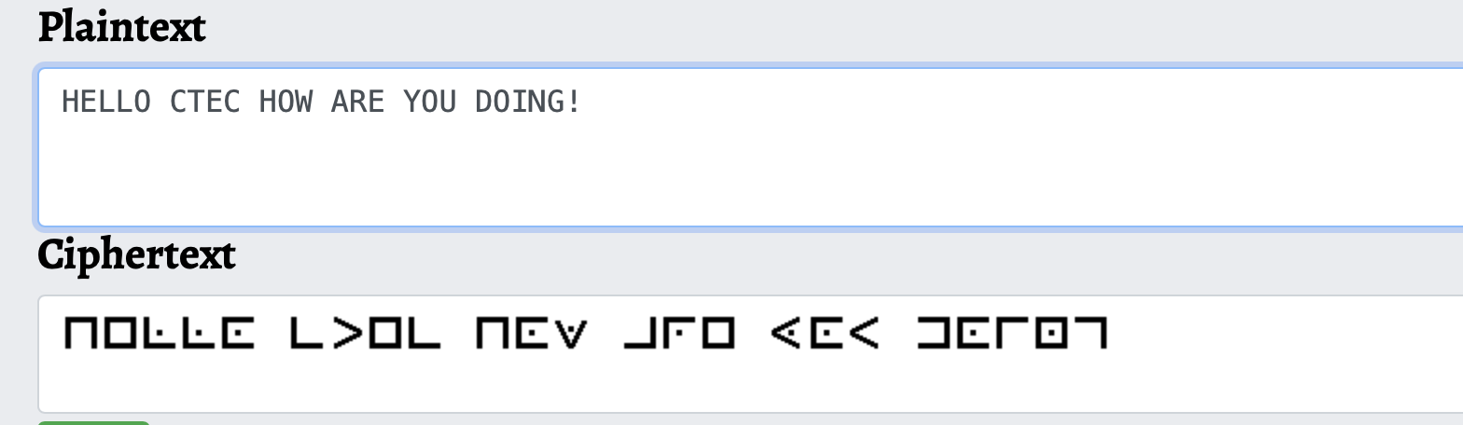
Encryption Process
Step 1: Write out the standard Pigpen Cipher key.
Step 2: Replace each letter in the message with its corresponding symbol.
Example: Encrypting "HELLO CTEC HOW ARE YOU DOING!
Common uses: Encoded notes, children’s puzzles, and historical documents.

Slide 5
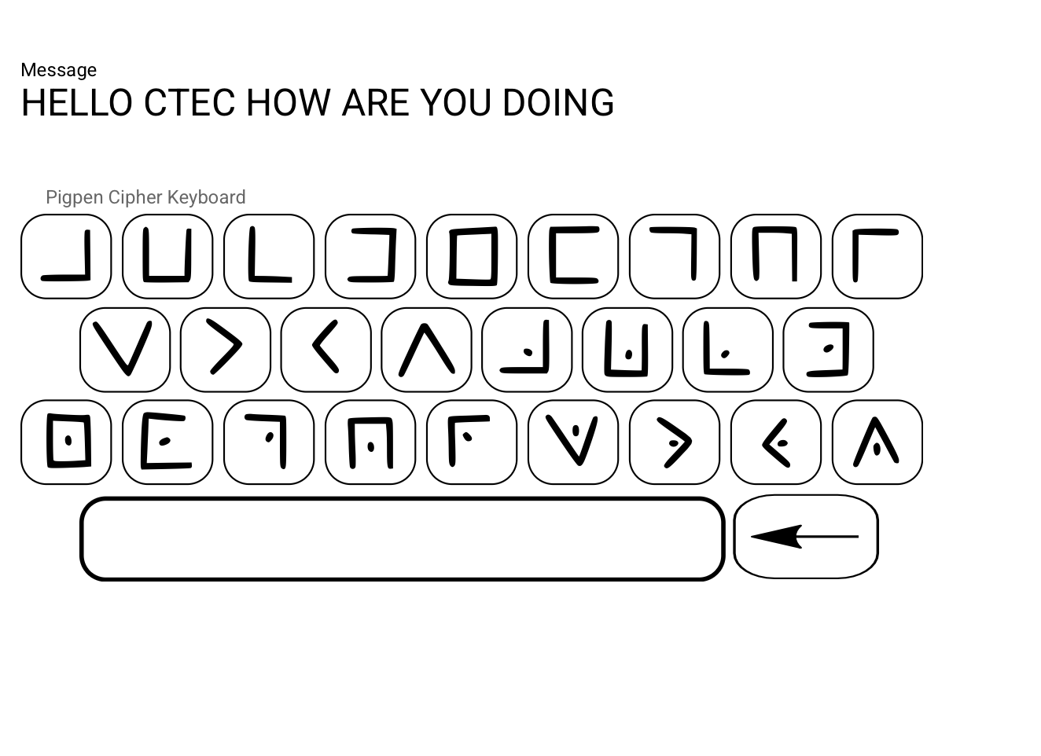
Decryption Process
Step 1: Identify the symbols in the encoded message.
Step 2: Use the Pigpen Cipher key to map symbols back to letters.
Example: Deciphering a Pigpen-encoded word.
HELLO CTEC HOW ARE YOU DOING!
Challenges: Without the key, it can be difficult for beginners to decode.

Slide 6
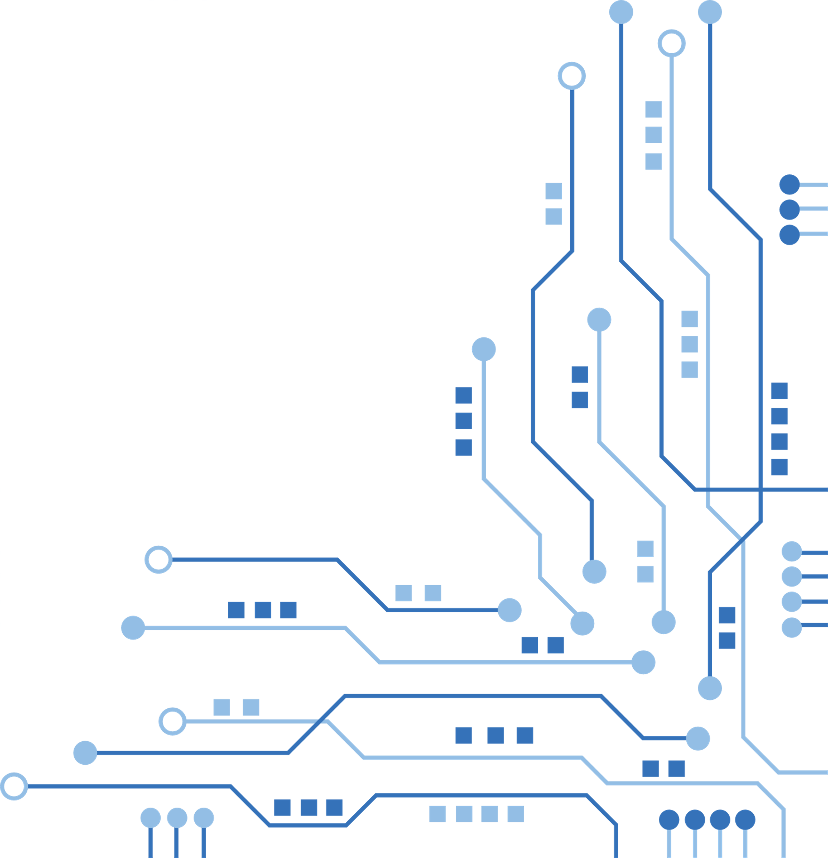

Applications of the Pigpen Cipher
Historical Uses
Modern Uses:
Used by Freemasons for secret communication and symbolic representation.
Seen in private correspondences during early espionage.
Popular in escape rooms, treasure hunts, and geocaching.
Used in children’s games and cryptography lessons.
Featured in pop culture and movies for mysterious messaging.

Slide 7
Strengths and Weaknesses –
Strengths:
Weaknesses:
Easy to learn and use, making it accessible for beginners.
The geometric symbols are visually distinct and memorable.
Can be written or drawn without specialized equipment. Simple to understand and implement.
Doesn’t require mathematical computation.
Visually distinct and fun for puzzles.
Easily breakable using pattern recognition techniques.
Vulnerable to frequency analysis—letter distribution remains unchanged.
No real security for modern encryption needs; unsuitable for confidential communication.
Once recognized, the Pigpen Cipher offers no resistance to decryption.
.

Slide 8
General Questions
What is the main purpose of cryptographic ciphers?
Answer : Cryptographic ciphers are designed to protect data by transforming readable information into an unreadable format, ensuring that only authorized parties can decrypt it. Their primary purpose is to ensure confidentiality and data integrity.
What is the difference between encryption and decryption?
Answer: Encryption converts plaintext into unreadable ciphertext using an algorithm and key to secure the data. Decryption reverses this process, turning the ciphertext back into readable plaintext using the appropriate key.
How do classical ciphers differ from modern encryption techniques?
Answer: Classical ciphers, like the Caesar cipher, are simple and vulnerable to analysis and cracking. Modern encryption techniques, such as AES and RSA, use complex algorithms and larger keys for stronger security, often incorporating public-key cryptography.
What is the significance of keys in encryption?
Answer: Keys control the encryption and decryption process, providing the means to transform data securely. The strength of an encryption system depends on the length and randomness of the key used.
What are the strengths and weaknesses of substitution ciphers versus transposition ciphers?
Answer: Substitution ciphers swap letters, but they’re easy to crack by looking at letter patterns. Transposition ciphers mix up the letters, which is harder to figure out, but still can be cracked with enough effort.

Slide 9
Security by Modern Standards
The Pigpen cipher is not secure by modern cryptographic standards.
It lacks complexity and does not provide sufficient protection against modern decryption techniques.

Slide 10

Pigpen Cipher Questions
How is the Pigpen Cipher different from other substitution ciphers? The Pigpen Cipher is a substitution cipher that replaces letters with symbols based on a grid or X pattern, making it visually distinct from traditional letter-based substitution ciphers.
Why was the Pigpen Cipher historically popular among secret societies? It was simple to use, easy to memorize, and visually obscure, making it effective for concealing messages from outsiders while still being easily recognizable to members.
What are the advantages and disadvantages of the Pigpen Cipher for modern use? Advantages: Easy to learn, Use, and Visually obscure. Disadvantages: Not secure, Limited practical use, and bulky/inefficient.
How would you encrypt the word “SECURITY” using the Pigpen Cipher?

Slide 11
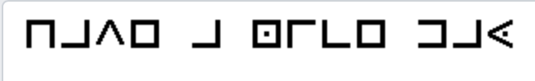
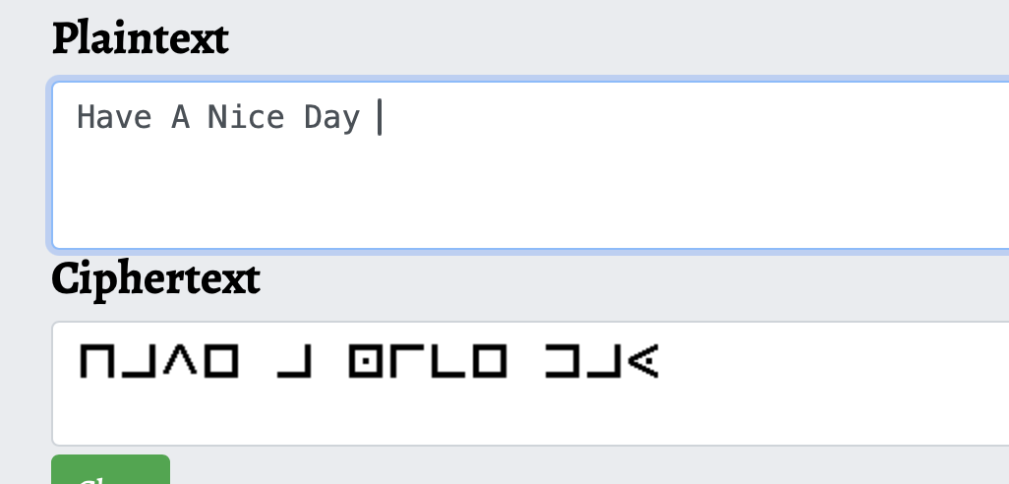
Live Demonstration
Message to Encrypt: Have A Nice Day.
Pigpen Cipher Key
Encrypted Message
Decrypted Message

Slide 12
Comparison to Caesar and Mixed Alphabet Ciphers
The Pigpen cipher is more visually complex but equally insecure. Both ciphers are vulnerable to frequency analysis.
The Mixed Alphabet cipher is more secure than Pigpen because it uses a randomized substitution key, making frequency analysis more difficult.

Slide 13
Conclusion
The Pigpen Cipher is a fun, historical, and easy-to-use encryption method.
While it served well in secret societies, it is not secure for modern use.
Key takeaway: Understanding historical ciphers can provide insights into cryptography’s evolution.

Slide 14
References
Wikipedia. (n.d.). Pigpen cipher. Retrieved [date], from https://en.wikipedia.org/wiki/Pigpen_cipher
Crypto Corner. (n.d.). How to use the Pigpen cipher. Retrieved [date], from https://cryptocorner.info/pigpen-cipher/
History.com Editors. (n.d.). History of cryptography. Retrieved [date], from https://www.history.com/topics/cryptography
(2023, February 9). Pigpen cipher. Wikipedia. https://en.wikipedia.org/wiki/Pigpen_cipher
Kahn, D. (1996). The codebreakers: The comprehensive history of secret communication from ancient times to the internet. Scribner.
Singh, S. (1999). The code book: The science of secrecy from ancient Egypt to quantum cryptography. Anchor.
Gardner, M. (1983). Codes, ciphers, and secret writing. Dover Publications.

Slide 15
Thank
You
Any Questions ?

